Slide 1
Contemporary gene discovery through genomewide association
Brien Riley
BNFO 653
3/03/2023

Slide 2
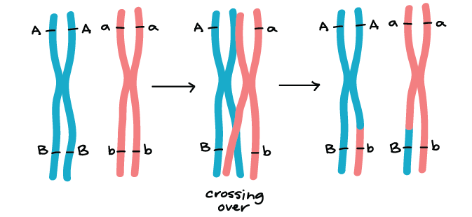
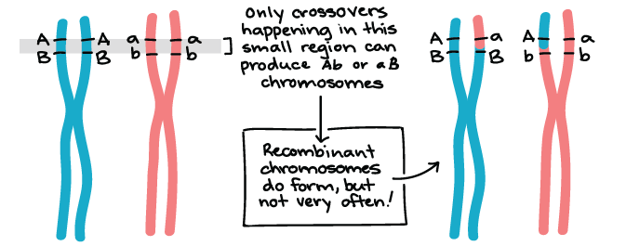
Linkage, Crossover & Recombination

Slide 3
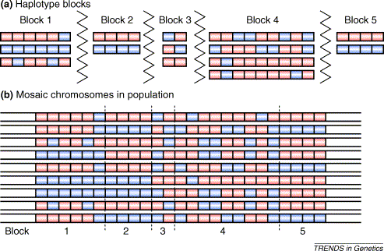
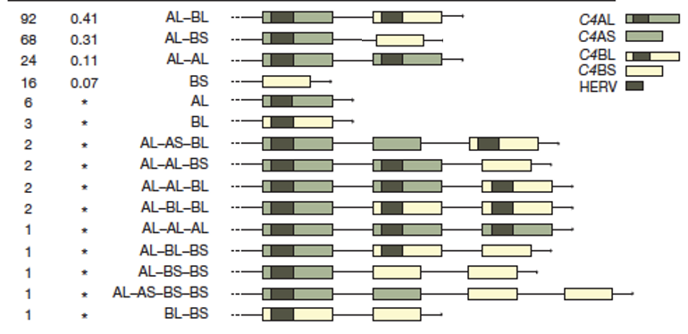
Haplotypes
Cardon & Abecasis, 2003

Slide 4
Haplotype Blocks
Cardon & Abecasis, 2003

Slide 5
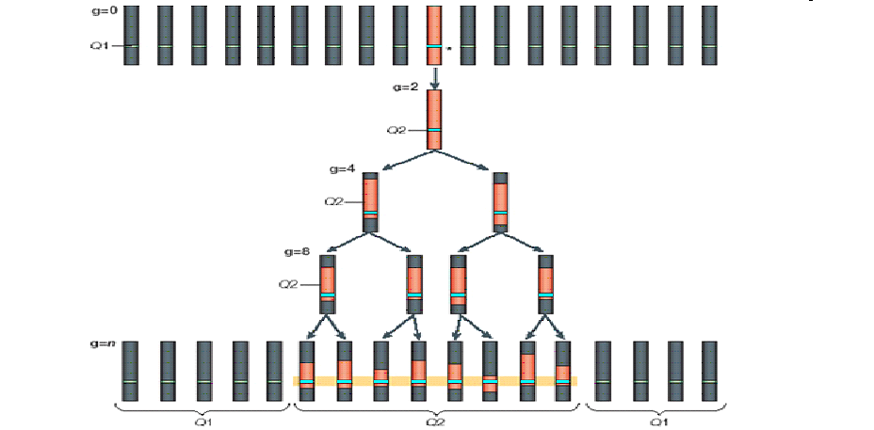
Linkage Disequilibrium

Slide 6
3 Definitions of Linkage Disequilibrium
1. Correlation between alleles at two loci
due to a new mutation/allele/SNP at locus 1 arising on a specific background haplotype containing the correlated allele at locus 2.
2. Non-random segregation of alleles at two or more loci
most general definition
3. Deviation from haplotype frequencies expected based on allele frequencies at two loci
simplest case: some haplotypes are not observed due to lack of recombination between the loci, or
more generally: deviation from expected haplotype frequencies due to limited recombination between loci

Slide 7
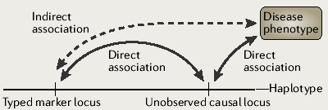
Allelic Association
Direct Causation or Relationship
HLA associations w/ Autoimmune Disorders
Indirect relationship via Linkage disequilibrium (LD)
genotyped marker is physically close to and in LD with a variant influencing the trait
Distinction less meaningful in the era of genome sequencing and imputation

Slide 8
Genetic association is applicable to many human traits
Most medical genetics focuses on diseases
Categorical or dichotomous traits (Yes/No, O/1)
Also applicable to quantitative traits (continuous values)
Height
BMI
These provide particular insight into the effects of genes
GWAS explicitly aimed at detecting common variation

Slide 9
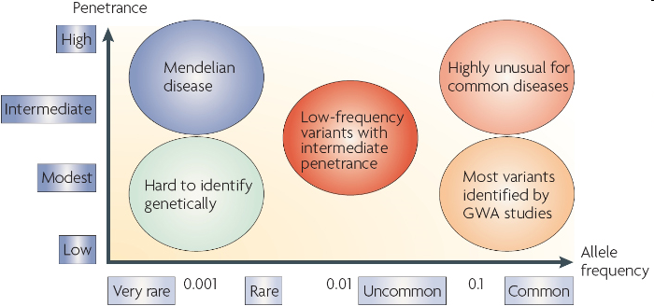
Models of Common and Rare Genetic Risk I

Slide 10
Models of Common and Rare Genetic Risk II
Huntington’s
HTT polyQ expansion
MAF 1 in 100,000
OR=100,000
Schizophrenia
22q11 del CNV
MAF 1 in 4000
OR=68
Variants associated
w/ common disease risk
MAF 1-40%
OR=1.05-1.3

Slide 11
Common disease/common variant (CDCV)
Risk allele frequency >5% (2K), >1% (10K), >0.1% (100K)
Effect size: allelic odds ratio (OR) ~1.05-1.3
Each allele: 5-30% increase over baseline risk
100s of risk alleles in the population
Each case carries a subset of the total N risk alleles
Variants may be individually neutral or even advantageous
Might explain high frequency

Slide 12
CDCV requires additional modeling
Simplest model is additive
Total risk from N variants is equal to the sum of the N individual risks
Environmental exposure likely important
Gene-environment (GxE) and gene-gene (epistatic) interactions possible
Epistasis: Total risk from N variants is greater than the sum of the N individual risks
But interactions challenging to detect meaningfully

Slide 13
APOE*ε4 and Alzheimer’s
Prototype CDCV allele
ε4 risk allele
Common: MAF up to 40% in some populations
Large effect (relatively): allelic relative risk* of 3
Selectively neutral: late-onset disease
Identified early because of high frequency and large
effect

Slide 14
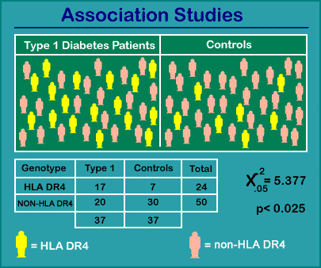
The human leukocyte antigen system (HLA) is the name of the human major histocompatibility complex (MHC).
This group of genes on chromosome 6 encodes cell-surface antigen-presenting proteins, etc
Highly variable
Implicated in many diseases with autoimmune involvement
ROCHE Genetic Education

Slide 15
Genomewide association studies (GWAS)

Slide 16
Risch and Merikangas, 1996

Slide 17
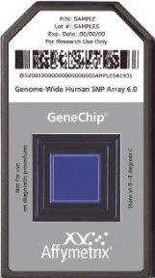
Development of SNP microarrays
Affymetrix
10K, 100K, 250K, 500K (2 arrays), 500K/420K CNV probes
SNPs selected for average physical spacing (poor)
Most common V6.0: 900K SNPs/1.8M CNV probes
Additional 400K SNPs selected for LD-tagging
Illumina
317K, 550K, 610K
SNPs selected based on LD maps
Current: 1M SNPs/60K probes for known CNVs
Technically better approach
Higher genotyping rates, few low MAF SNPs, LD-based
Other providers and techniques for in-house production

Slide 18
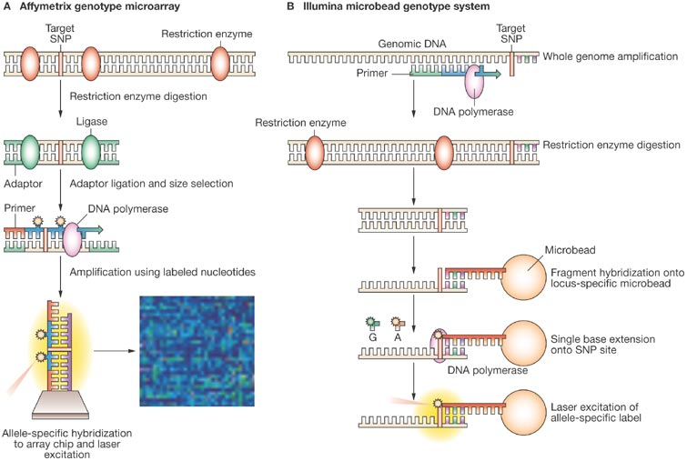

Slide 19
Issues in GWAS study design
Large, high-power samples
Stratification, appropriate controls and phenotypes
Technical issues
Careful data cleaning and QC
Appropriate analysis
Stringent significance thresholds
Replication critical
Issues common to all high-throughput, genomewide approaches

Slide 20
Power & Sample N
Table R1. Comparative power for samples of 400 cases/1000 controls and 2357 cases/2000 controls for the primary analysis. Values >80% are shown in bold.
Allelic OR | RAF | N Cases/Controls
 |  | 400/1000 | 2357/2000
1.2 | 0.1 | 0.001 | 0.045
 | 0.2 | 0.004 | 0.2
 | 0.3 | 0.007 | 0.338
 | 0.4 | 0.009 | 0.401
 | 0.5 | 0.009 | 0.39
1.3 | 0.1 | 0.006 | 0.35
 | 0.2 | 0.03 | 0.784
 | 0.3 | 0.057 | 0.907
 | 0.4 | 0.07 | 0.932
 | 0.5 | 0.066 | 0.917
1.4 | 0.1 | 0.03 | 0.802
 | 0.2 | 0.128 | 0.989
 | 0.3 | 0.214 | 0.998
 | 0.4 | 0.245 | 0.999
 | 0.5 | 0.223 | 0.998
Power: probability of rejecting a false null hypothesis
Probability an effect will be detected if present
Power depends on:
Sample size
Allelic OR
Risk AF

Slide 21
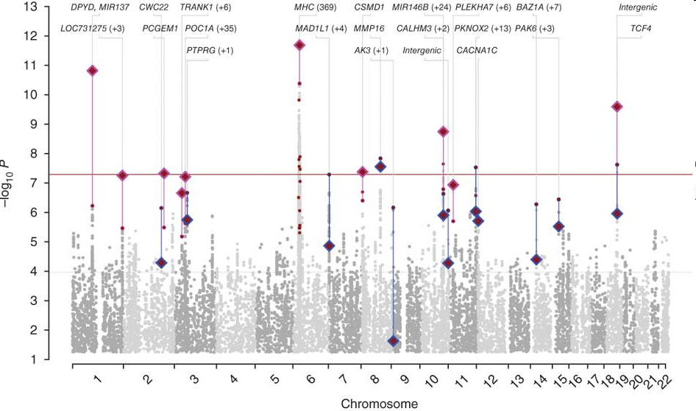
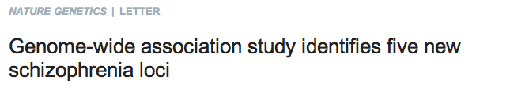
PGC - The Past - 2011
q
9394 cases, 12462 controls
5 genome wide significant sites

Slide 22
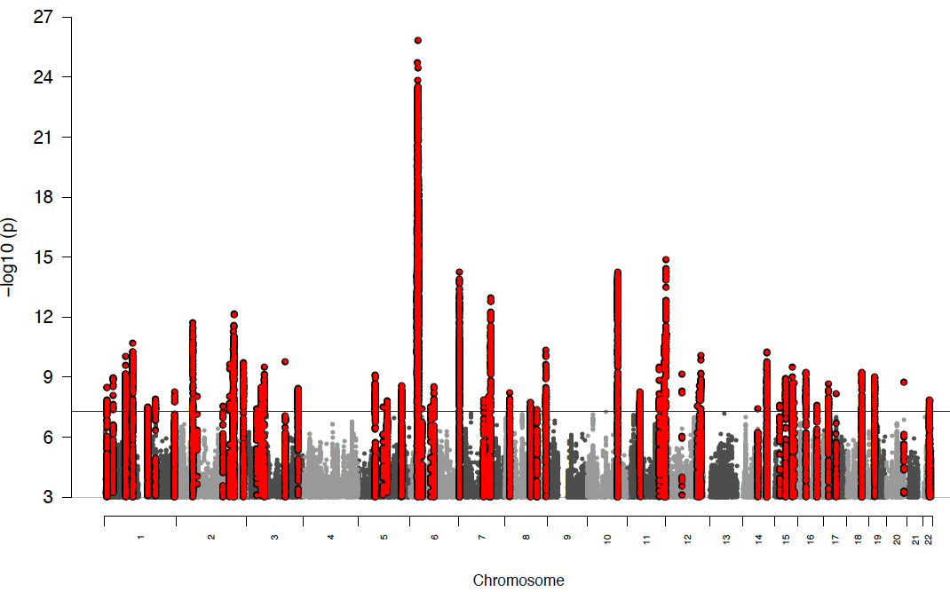
PGC2 2012 Mega-analysis results
UNPUBLISHED REPORT FROM PGC-SCHIZOPHRENIA GROUP, HAMBURG October 2012
25785 cases, 28441 controls
62 genome wide significant sites

Slide 23
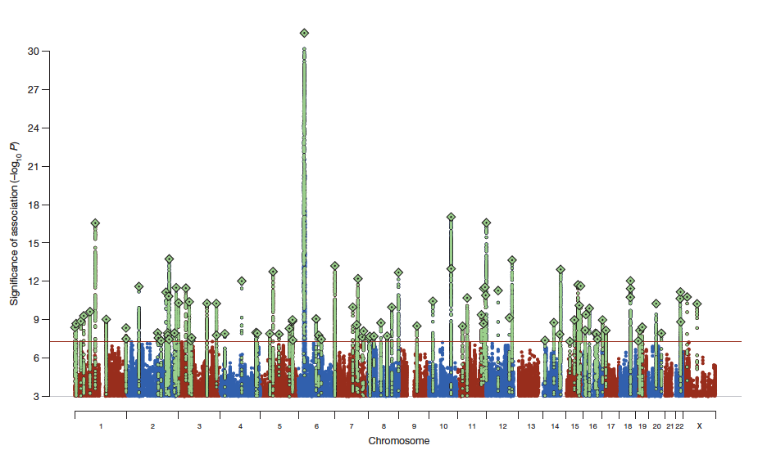
PGC2 2014 Mega-analysis results
34241 cases, 45604 controls
108 genome wide significant sites

Slide 24
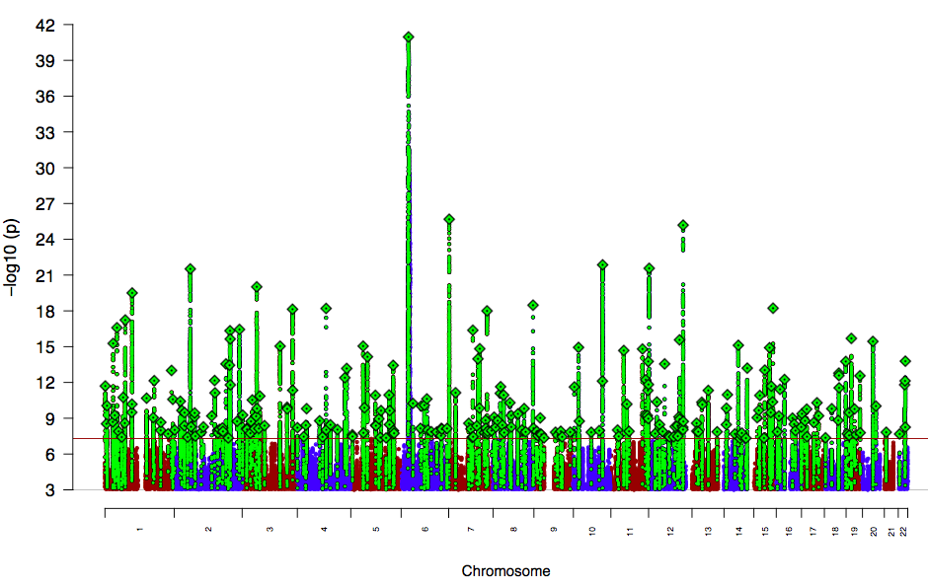
PGC2 2017 Mega-analysis results
65,205 cases and 87,919 controls
256 genome wide significant sites

Slide 25
PGC2 2022 Mega-analysis results
Common variant sites for schizophrenia, 2020
67,390 cases and 94,015 controls
270 genomewide significant sites

Slide 26
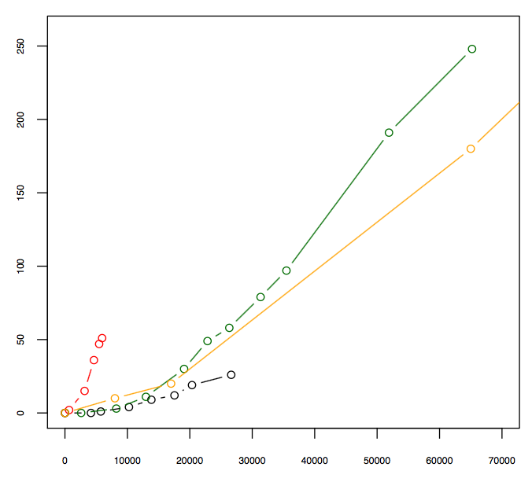
Associated loci as function of sample size
PGC w3
Schizophrenia: ~ 4 / 1,000
PGC w3 (European)
PGC w3 (75K/155 loci)
N Hits (p < 5.0 * 10⁻⁰⁸)
PGC w2 (35K/108 loci)
PGC w2
Adult Height: ~ 3 / 1,000
Crohn’s: ~ 10 / 1,000
(Bipolar Disorder: ~ 3 / 1,000)
N cases

Slide 27
Population Stratification
Patterns of LD vary by population
If cases and controls
1) Come from completely different populations (rare)
2) Have different proportions from different populations (common)
Spurious association can be detected
Driven only by population differences, not by true association of trait with a variant allele
Can be avoided by carefully limiting or matching continental ancestry
Can also be addressed in analysis (analyze within strata and combine meta-analytically)

Slide 28
Wellcome Trust Case/Control Consortium (WTCCC) study
Most important of first round GWAS
Major validation for Common Disease, Common Variant idea

Slide 29
WTCCC samples
2000 cases each of 7 common disorders
Crohn’s disease (9)
rheumatoid arthritis (3)
type 1(insulin-dependent) diabetes (7)
type 2 (non insulin-dependent) diabetes (3)
bipolar disorder (1)
coronary artery disease (1)
hypertension (0)
3000 shared population controls
24 independent association signals at P<5 x 10⁻⁷

Slide 30
WTCCC controls
3000 samples WTCCC1, 6000 WTCCC2
1958 Birth Cohort, anonymous UK blood donors
All case and control samples UK caucasian
Come from same population
Population stratification unlikely to be an issue
“Population” controls, not screened for any trait
Expect trait to occur at population frequency
Effect on power depends on % controls who are or will become affected (population frequency of disease)
If 5% of controls meet definition of cases
loss of power ≈ reduction of sample size by 10%

Slide 31
The less exciting end of the WTCCC
Bipolar disorder: 1 SNP significant at 5 x 10-7
Not replicated in a second bipolar GWAS
Hypertension: 0 SNPs significant at 5 x 10-7
How can we explain these results?
Phenotype?
Bipolar?
Hypertension?
Genetic architecture different for these traits?
More extreme locus heterogeneity?

Slide 32
Phenotype: Hypertension I
Hypertension: phenotypic definition
Dichotomous: hypertension case/control
Quantitative: individual’s blood pressure
In this situation, Quantitative more powerful
Consider a case (> threshold BP) compared to
A control in the bottom 10% of BP
A control with BP just below threshold
Dichotomous measurement treats these two controls identically
Quantitative measurement maintains and uses the difference between the two controls

Slide 33
Phenotype: Hypertension II
Hypertension: lack of control screening
If trait <1-2% (eg, schizophrenia, 1%), little impact
Hypertension frequency in population is 20%
What is the impact of unscreened controls here?
What % of controls likely have hypertension?
What is the impact on effective sample size?

Slide 34
Phenotype: Hypertension III
Hypertension: substantial environmental component
Salt, alcohol, smoking, exercise
No environmental data included in this study
Important risk factors not considered
Likely variation in relative risk from genes and environment
Important to include environmental variables where known
Include as covariates
Control for effect

Slide 35
Technical issues
High quality DNA samples
Batch effects:
Run sample using same lot of reagents
Include in each run
Parents (Mendelian errors),
Duplicate DNA (genotyping accuracy)
Common DNA (genotyping consistency)
Mix cases and controls in every plate/run (CRITICAL)
Site effects: same platform, different sites, systematic differences (can only address analytically)
Skilled technicians

Slide 36
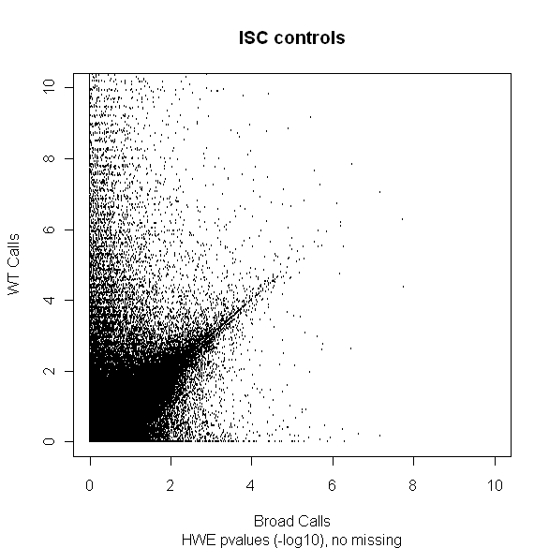
Differential Error in two Control Sites
Hardy Weinberg Equilibrium in Controls
Hardy Weinberg Equilibrium: p²+2pq+q²=1
Deviations from HWE may indicate genotyping error
GWAS: Generally remove SNPs with HWE p –values <10e-6
Expect the same SNPs from the two sets of an Irish population to have the same distribution of HWE
Affymetrix HWE –log10(p-values)
Broad HWE –log10(p-values)
Notes:
-already knew needed to deal with site difference issue before cases -were genotyped
-HWE: alleles are in certain proportions; out of HWE indicates error

Slide 37
Data cleaning and QC
Array level: exclude poor performing arrays
SNP level: Exclude SNPs with
High % missing genotypes (poor SNP)
Low HWE p-values (poor SNP)
Very low MAF, <1% (low power, pointless test)
Sample level: Exclude DNAs with
Excess matching genotypes (relative/duplicate)
High % missing genotypes (poor DNA/handling)
Excess heterozygosity (contaminated/degraded DNA)

Slide 38
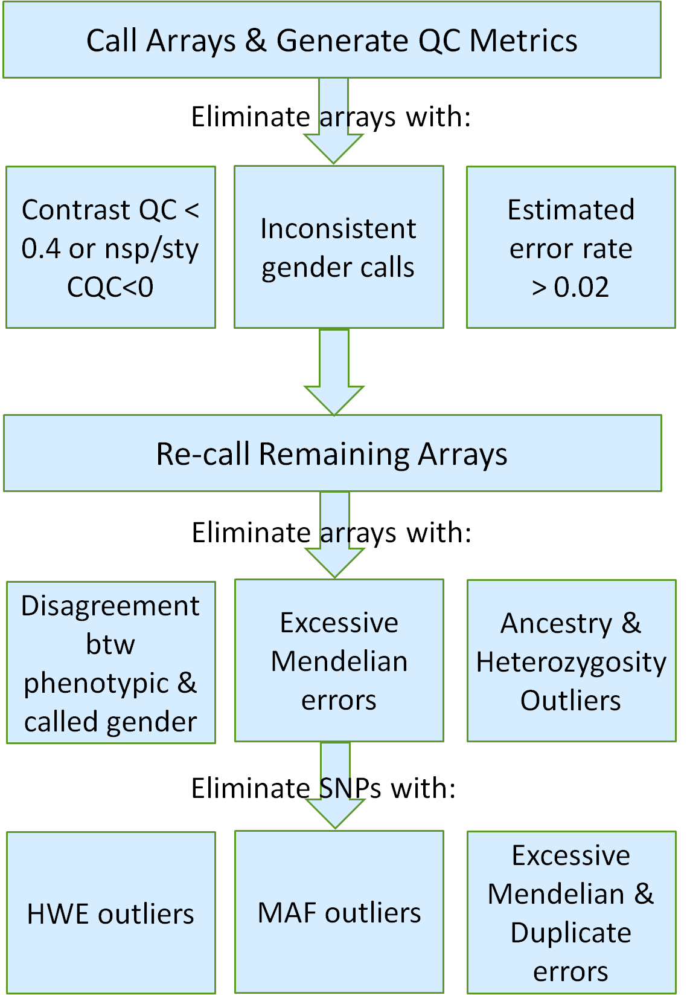
Rigorous QC Process
Call Arrays with Birdseed
Case Sample N=815 | SNPs N= 800,999
CQC/Sex=780 | Mendel/Duplicate Error=737,997
Ancestry/Het/Sex/pi-hat=762 | MAF < 1%= 686,682
Lesser quality dup=710 | Missingness= 676,736
Call Arrays with BC
Notes:
-Attempted to eliminate samples & SNPs with greatest error to reduce differential error btw cases & controls
Re-called arrays because even a few poor quality samples can “profoundly” affect the call rate of good quality samples (Pluzhnikov et al., 2010)
-rigorous QC process to attempt to eliminate differential error caused by genotyping cases at one site & controls at another

Slide 39
Assess “quantile-quantile (q-q)” plot
Is p-value distribution different from theoretical (eg, chi-square)
Plot observed vs. expected p-values
Under assumption of small N (10’s-100’s) loci with true effect, expect small N of departures from expected distribution
Specific biases from sources above
Plot 95% “concentration band”
expect 95% points to lie in band
Departure evidence for either stratification, genotyping error/bias or association

Slide 40
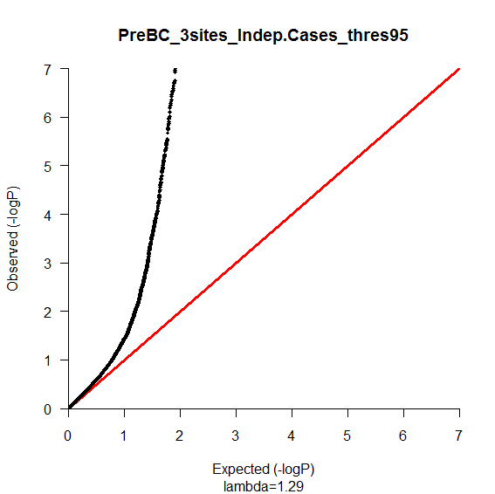
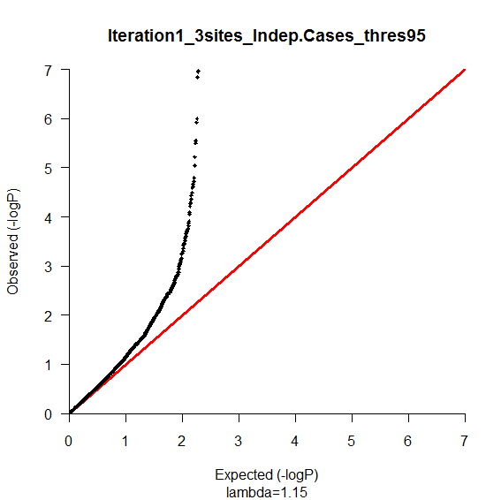
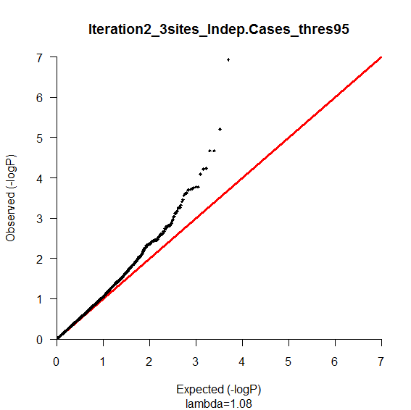
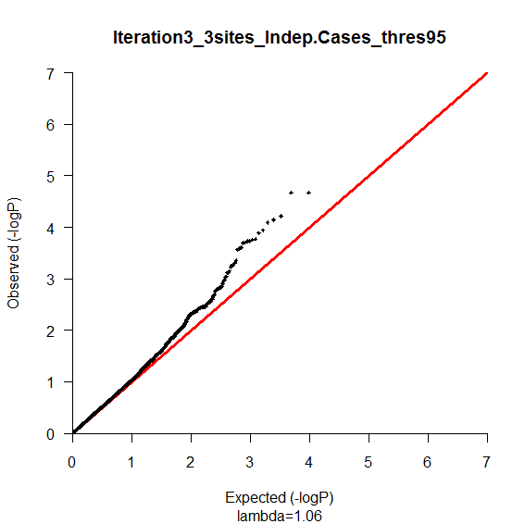
Pre- & Post-BC Q-Q Plots of 2 Control Sites
Before BC
Iteration 1
λ=1.29
λ=1.15
Genomic Inflation Factor (λ): measures extent to which distribution is inflated
Iteration 2
Iteration 3
λ=1.08
λ=1.06
Notes:
-inflation across entire distribution
-

Slide 41

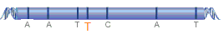
BeagleCall (BC)
Uses both normalized allele signal intensities & LD information to generate genotype calls
Genotyping
Module
Haplotype Inference
Module
T
Iterative process with increasingly stringent filters
Iteration 1: probability < 0.80; marker missingness > 0.20
Browning et al., 2009
Notes:
-Probability 97% to each genotype;
-Birdseed calls: if called as AA, 100% for AA and 0% for other two possibilities
-If missing, 33% across the board
-The genotype likelihood P( SjG ¼ g) is the estimated probability density of the observed allele signal intensity S if the true genotype is g.
-Each iteration, increase the stringency of filters
-any marker whose genotype probability < 97% in a particular sample’s genotype probabilities file is set to missing
-any marker with >3% of samples having missing genotypes will be excluded
-Suggested filter levels for Affy data:
Iteration 1: callthreshold=0.8; missingcohort=0.2
Iteration 2: callthreshold=0.96; missingcohort=0.04
Iteration 3: callthreshold=0.97; missingcohort=0.03

Slide 42
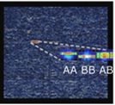
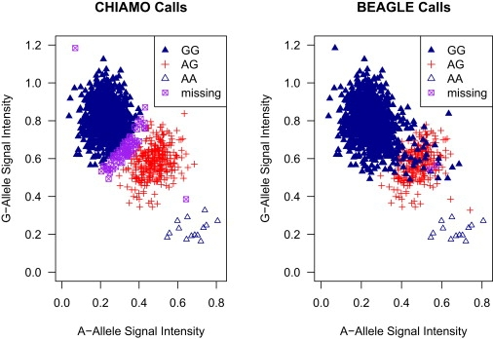
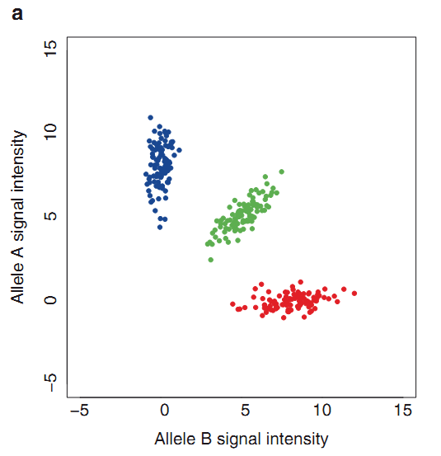
BeagleCall
GG
AG
AA
Browning et al., 2009

Slide 43
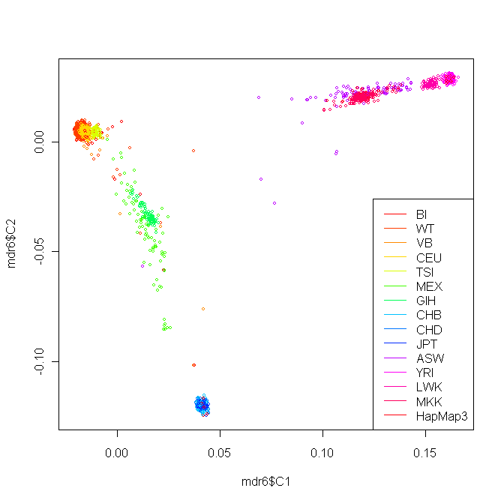
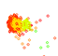
Post-QC Ancestry Principal Components
Dimension 2
Ancestry Analysis: Goal is to reduce a large number of correlated variables (relationship estimates) into a smaller # of variables (dimensions)
HapMap
Dimension 1
Courtesy of Dr. Webb

Slide 44
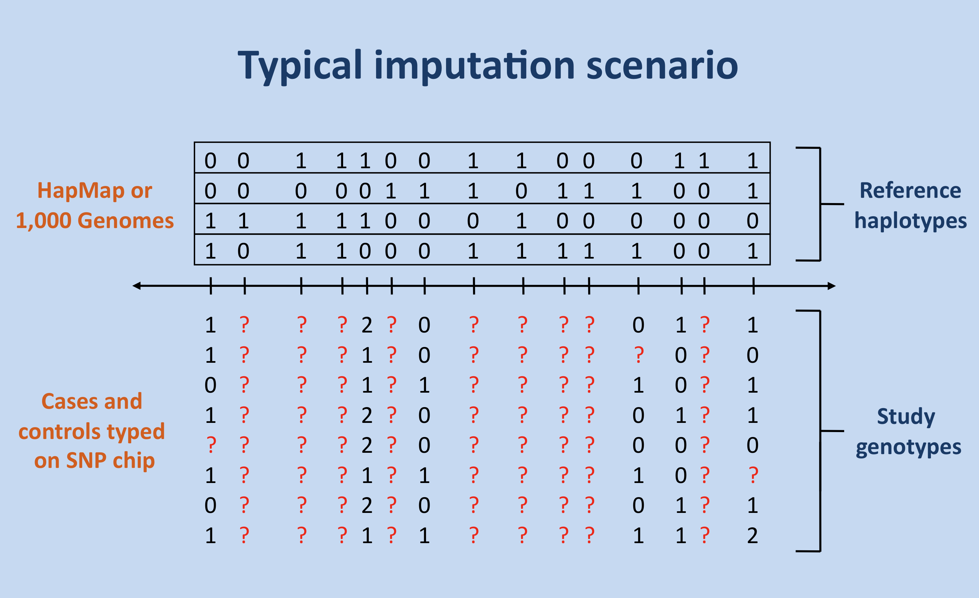
Imputation: inference of alleles at ungenotyped SNPs based on known LD patterns
Facilitates meta-analyses
Predict genotypes not directly assayed, recover QC-lost genotypes (Marchini et at., 2010)
Notes:
Haplotypes – set of marker alleles inherited from one parent

Slide 45
Imputation: requires a reference
1000 genomes March 2012 haplotype reference panel
35 million SNPs genomewide, ~8.5 million SNPs with MAF >1%
Haplotype Reference Consortium reference panel
Use reference to phase sample data into haplotypes
Predict probability of each possible genotype in sample based on haplotypes in the more complete reference
Probabilities then converted to dosages (0-2)
Single probabilistic estimate of N of minor alleles
SNP 1 : Probability Dosage
AA AB BB → AA AB BB
0 0.25 0.75 0 x 0 + 1 x.25 + 2 x .75 = 1.75
Notes:
Haplotypes – set of marker alleles inherited from one parent

Slide 46
Appropriate Statistical Tests & Significance Levels
Chi-square: good if no stratification
Cochran-Armitage Test for Trend:
Modified chi-square for 2 x k categories
Incorporate suspected ordering, eg allele dosage
Valid with modest departure from HWE (keep more SNPs)
Allele & genotype tests equivalent when HWE holds (fewer tests)
Cochran Mantel-Haenszel Test:
Control for categorical stratification, include categorical covariates
Logistic regression:
Quantitative traits
Control for quantitative stratification, include quantitative covariates
Bonferroni correction: appropriately correct for N of independent tests
1 million SNPs/tests (current arrays), 5 x 10⁻⁸
1.6 million independent LD segments, 3.2 x 10⁻⁸

Slide 47
2 regions close-up 2.5 Mb region
12q24 (TID) diffuse many genes 16q12 (T2D) focal FTO

Slide 48
Type 2 diabetes: robust replication

Slide 49
Assessing h² (risk variance) accounted for
Multiple methods asking related but different questions
All focus on proportion of heritability (h²) explained
1. Sum scores: % of h² from significantly associated variants?
Tally N of risk alleles at statistically significant loci
If 20 loci, maximum score is 40 (2 x N loci)
Least widely used of three methods
Why is this approach limited?
Only includes significantly associated loci
N of associated loci heavily dependent on sample size

Slide 50
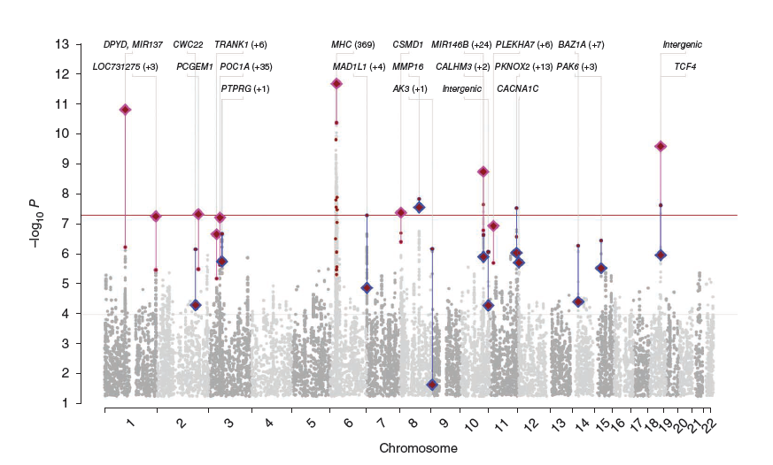
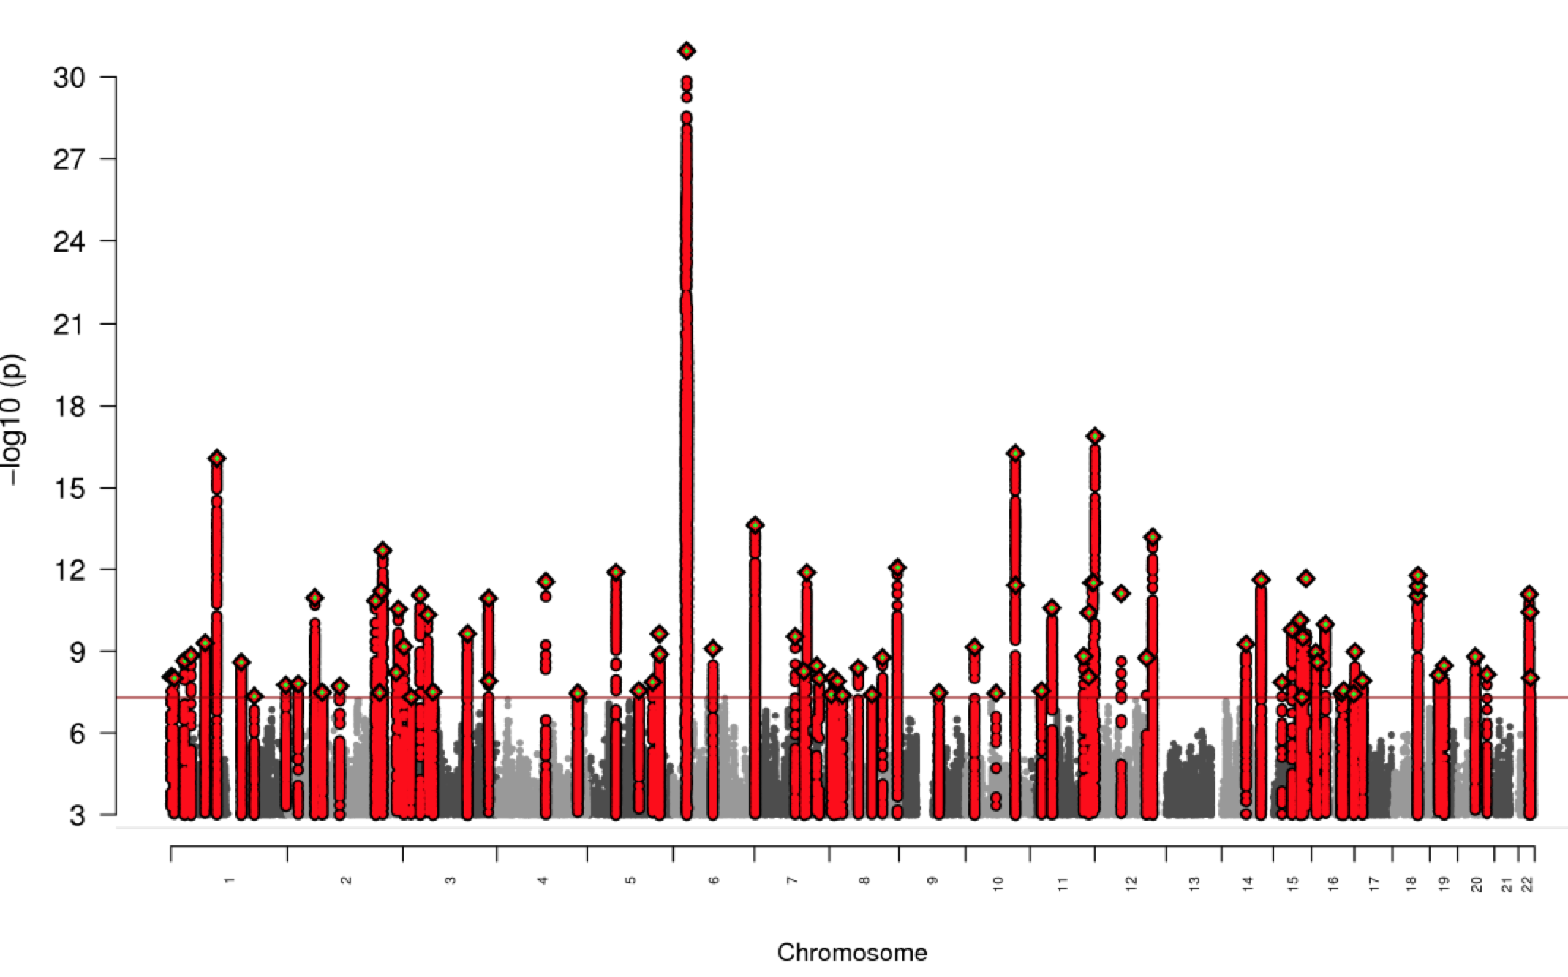
26 K/28 K, 62
9 K/12 K, 5
35 K/46 K, 97
35 K/46 K +
DeCode, 108

Slide 51
The missing variance problem example: GWAS of normal human height
Adult height is a model polygenic trait
limited success in identifying genes underlying normal variation*
Discovery: GWAS data from 13,665 individuals
Replication: genotyped 39 variants in additional 16,482 samples
20 variants associated with adult height (P < 5 × 10−7)
Combined, the 20 SNPs explain ~3% of height variation
~5 cm difference between
6.2% with lowest N ‘tall’ alleles
5.5% with highest N ‘tall’ alleles
But height has a major dietary component (protein)

Slide 52
Sum Score results from 4 traits/diseases
IBD (Crohn’s/UC) (2014)
163 loci, 13.6% (CD), 7.5% (UC)
Type 2 diabetes (2014): 70 loci, 10%
Blood lipids (2015): > 100 loci, < 15%
Multiple phenotypes (blood triglycerides, HDL, LDL)
Substantial overlap in loci
Height (2013): 180 loci, 10-12%

Slide 53
A broader approach estimating heritability accounted for beyond significant loci
2. Polygenic risk score (PRS): estimate total risk variance accounted for by SNPs with p < threshold
Allow for incomplete discovery of loci, estimate N loci involved
Choose significance threshold(s), p<0.2 is a common value
2 common uses:
1) Single threshold: calculate PRS in sample 1, then test how well PRS predicts case status in sample 2
2) Multiple thresholds: calculate heritability/variance accounted for at each threshold
Observe point at which variance accounted for maximizes
Estimates total N loci to be discovered

Slide 54
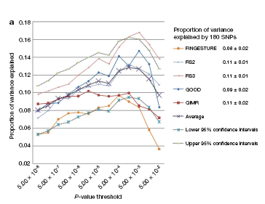
Purcell Polygene score approach

Slide 55
h² or risk variance accounted for genomewide
3. Visscher and Wray Genomewide Complex Trait Analysis (GCTA) approach: what proportion of heritability (additive genetic risk) does the whole genome account for?
Accept that not all loci yet identified, use all data genomewide
Compute variance accounted for by whole genome dataset
Estimate proportion of total heritability/risk from, eg, twin studies, accounted for by genomewide common variation?
May underestimate, but results generally indicate ~50% twin heritability accounted for by genomewide common variation

Slide 56
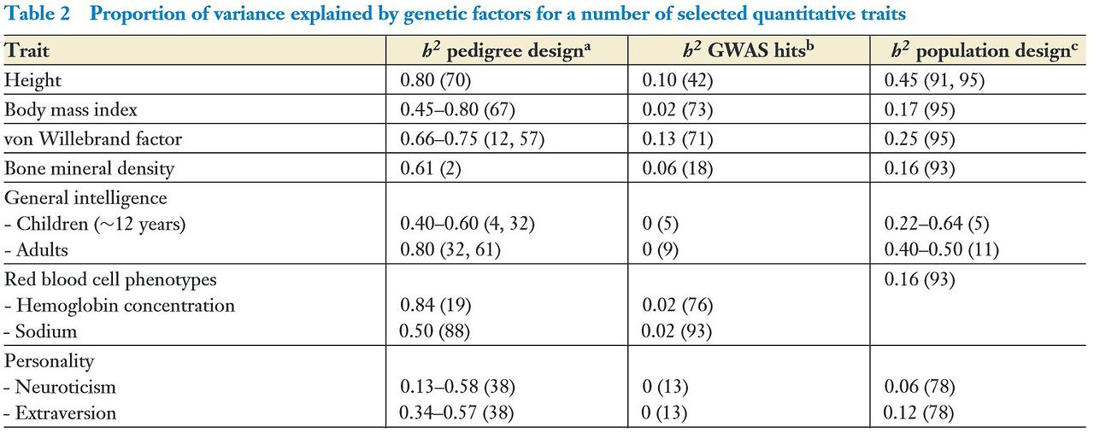
Genomewide approach (GCTA)

Slide 57
Why is so little variance accounted for?
Do twin studies overestimate heritability?
Equal environment invalid?
How else do twins differ at DNA level?
No test of interaction (non-additive) effects
GxG: heteromultimeric receptors, eg
GxE: is the environment important?
Active area, but statistically challenging
Impact of rare variation?
CNV and rSNV both contribute
Below risk AF threshold for GWAS

Slide 58
Missing Heritability II.1
Using GCTA, first calculated heritability due to common SNPs
Height heritability from family/twin data: 0.80
BMI heritability from family/twin data: 0.40
Common SNPs do not capture all the expected heritability

Slide 59
Missing Heritability II.2
Then added whole genome sequence data
Calculated heritability due to common + rare SNPs
Height heritability from family/twin data: 0.80
BMI heritability from family/twin data: 0.40
Common + rare SNPs capture >90% of expected heritability

Slide 60
PGC Schizophrenia Chromosome 6 Locus

Slide 61
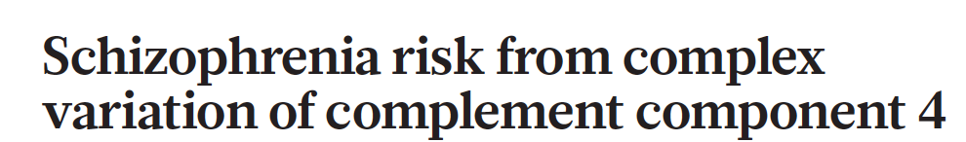
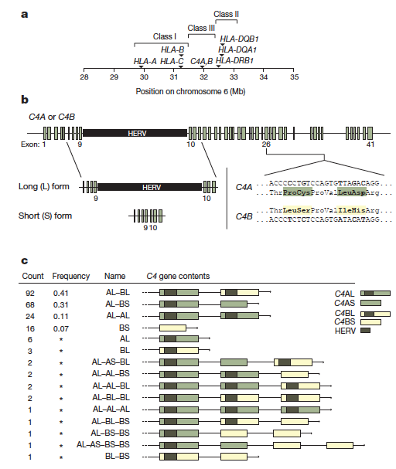
- PGC signal focal to CSMD1
- encodes a regulator of C4
Mark Daly
Notes:
Eric Lander!!

Slide 62
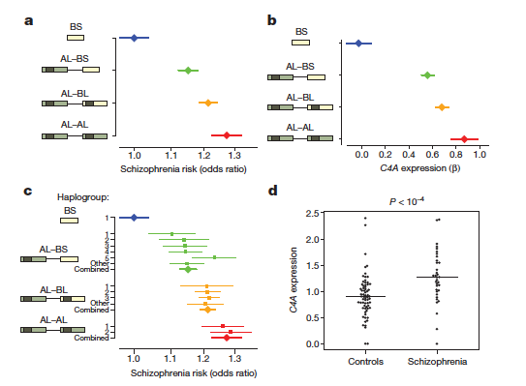
Mark Daly
Notes:
Eric Lander!!

Slide 63
Known Function of Complement 4
C4 activates C3
Immune system: active C3 binds targets, promotes phagocytosis by C3R-expressing cells
Developing brain: active C3 marks some synapses for elimination (“pruning”) by microglia
Hypothesis:
Reduced C4 expression, reduced pruning?
Increased C4 expression, increased pruning?
Notes:
Mice lacking functional C4 exhibited greater overlap between RGC inputs from the two eyes (P < 0.001) than wild-type littermate controls, suggesting reduced synaptic pruning

Slide 64
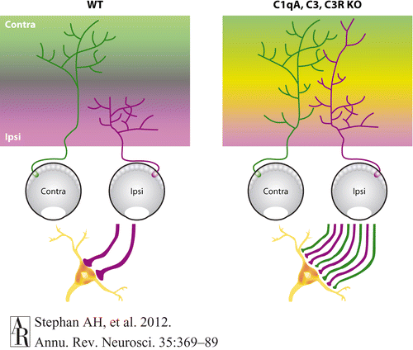
Complement cascade proteins mediate synaptic pruning in mouse retinogeniculate
Post-natal week 1: retinal ganglion cells from both eyes form connections with relay neurons in dorsolateral geniculate nucleus (dLGN)
Normally, these are pruned to 1-2 inputs from either right or left eye (left)
Complement 3 (C3) gene k/o show increased binocular innervation of dLGN relay neurons (right), interpreted as failure of normal synaptic pruning
Notes:
a classical model for studying activity-dependent developmental synapse elimination

Slide 65
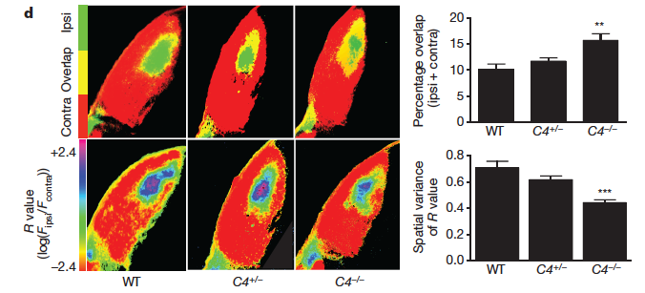
C4 w/t animals: low levels of overlapping ipsi- and contralateral RGC innervation of dLGN relay neurons
C4 +/- and -/- k/o animals: increased overlapping ipsi- and contralateral RGC innervation of relay neurons
Loss of C3 (above): reduction in expected synaptic pruning
Loss of C4 (here): reduction in expected synaptic pruning
Next question: what is effect of C4A:C4B expression on pruning?
Notes:
Mice lacking functional C4 exhibited greater overlap between RGC inputs from the two eyes (P < 0.001) than wild-type littermate controls, suggesting reduced synaptic pruning

Slide 66
Epigenome: functional modifications of the genome regulating chromatin structure and gene expression (do not alter sequence)
ATAC-Seq
ATAC-seq and RNA-seq
in each cell type for eight
lines (“core-8”) and ATAC-seq
for 12 additional lines in NPCs
and iN-Glut;
identified 256,000-337,000
OCRs [FDR < 0.05] per cell type
Figure S8

Slide 67
Figure 1
20 individuals heterozygous for PGC-SCZ2 SNPs at ~70/108 loci,
generate iPSCs and differentiate into NPCs, glutamatergic, GABAergic and
dopaminergic neurons with high purity (75 to 90%)

Slide 68
In derived NPC, glutamatergic, GABAergic and dopaminergic neurons
Map open chromatin using ATAC-Seq
Measure gene expression using scRNA-Seq
Overlay with chromatin conformation data
Identify individual variant(s) from GWAS association signal where
Associated allele alters open chromatin
Associated allele affects gene expression (is an eQTL)
Nominate individual variant

Slide 69
CRISPR editing to homozygosity reveals significant reductions in
gene expression
PSD95+/SYN1+ synaptic puncta
Reduced firing rate

